Slide 1
An Introduction To Flash Application Development
Greg Dietsche

Slide 2
Welcome
To an introduction to FLASH app development
A brief overview:
Origin
Concept apps
Design considerations
Debugging / Testing

Slide 3
Introduction
I live on a Farm
I attend Concordia
University Wisconsin in Mequon, WI
Major: Computer Science
10+ Years of Programming Experience
5 Years in the TI-Calculator Community

Slide 4
In The Beginning
Calculator programming
TI-81 BASIC programming
TI-85 ZShell (1996)
TI-83 built-in ASM support

Slide 5
Shortly Thereafter
TI-92
Fargo
TI-89, TI-92 Plus, V200
The CPU is similar to older Apple computers
Kernel or no kernel?
FLASH memory

Slide 6
What Is A Flash App?
Flash Applications
Work well with Useful & Functional Ideas
Interact with the user
May Add BASIC Commands
Look and Feel Like OS Apps
Can customize the OS using the built-in API

Slide 7
Flash Application Advantages
Run from the FLASH memory
Copy protection
Event driven interaction with the user

Slide 8
What Do You Need To Create An App?
TI-FLASH studio
AMS API documentation
A problem (don't create one!)
Knowledge of C
68k ASM experience is helpful

Slide 9
Problem
What is the problem?
What does the user need?
What does the user ‘think’ they need?
What can be done with the resources at hand?

Slide 10
Problems Cont...
Technology as a silver bullet?
Counting stacks of shims
Studying for tests

Slide 11
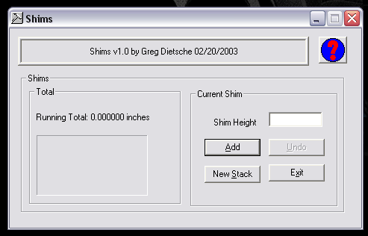

Slide 12
Concept
Once a problem has been identified
Specify exactly what the app will do
Prototypes

Slide 13
Design Considerations
KISS
The user is #1
User interface
Complexity of code
Implementation goals
Avoid adding too many features

Slide 14
App Development
A brief tour of TI-FLASH studio
A sample application

Slide 15
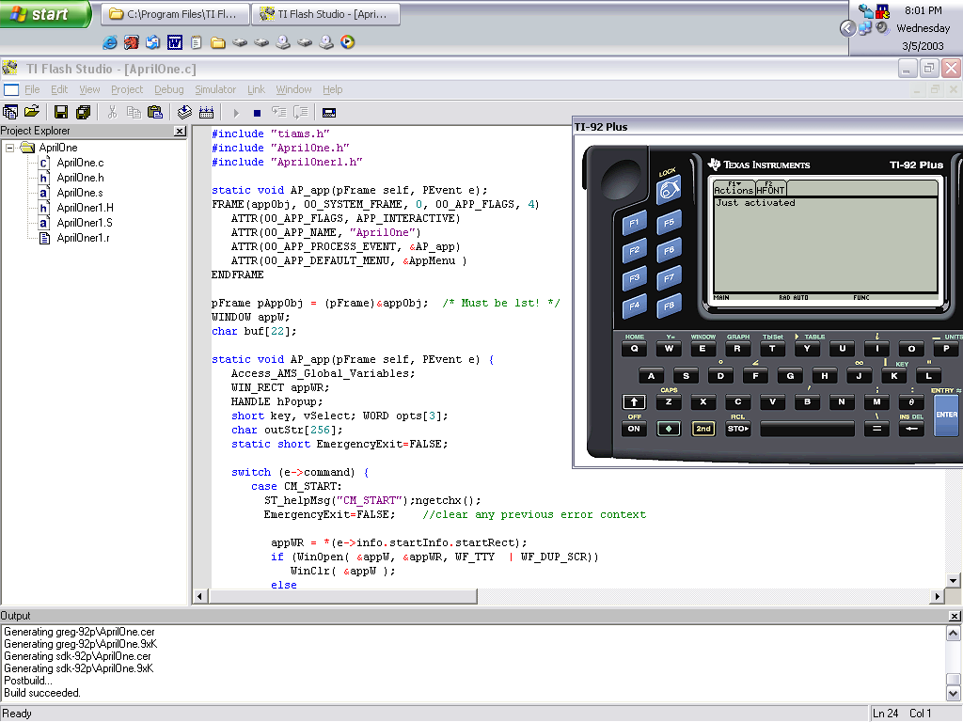

Slide 16
Command Post
Written to solve a specific problem
Designed with flexibility in mind
Helps programmers create better software

Slide 17
Features
Anti-crash protection
Leak watch
Low RAM simulation
App info
Misc. Other

Slide 18
Leak Watch
Memory allocation is dynamic
Detecting leaks (how)
Example

Slide 19
Low RAM Simulation
What it does
How is this useful?
Example

Slide 20
Application Information
Application Control Block
FLASH App Header
Flag Translations
Example

Slide 21
Misc. Other
OS Information
Heap Dump
BASIC Extensions

Slide 22
Anti-crash Protection
Complete Integration
Advantages over RAM based crash protection
BASIC Example
ASM Example

Slide 23
A Sneak Peek
Disassembler
Crash Protection Integration

Slide 24
Questions?
Ask now
... or later
Contact Me via EMail:
greg@gregd.org

Slide 25
Thank You

